Slide 1
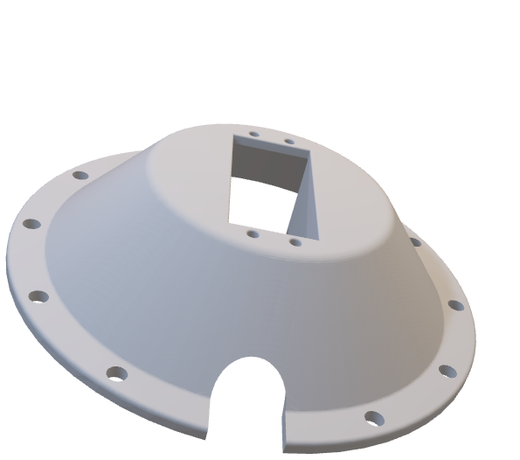
Base Interface

Slide 2
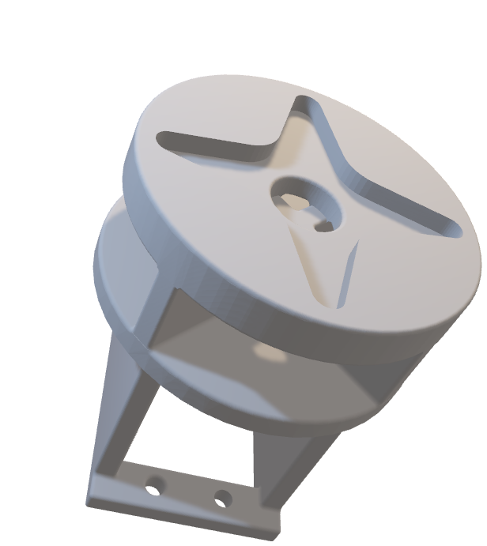
Axial link (Trunk)

Slide 3
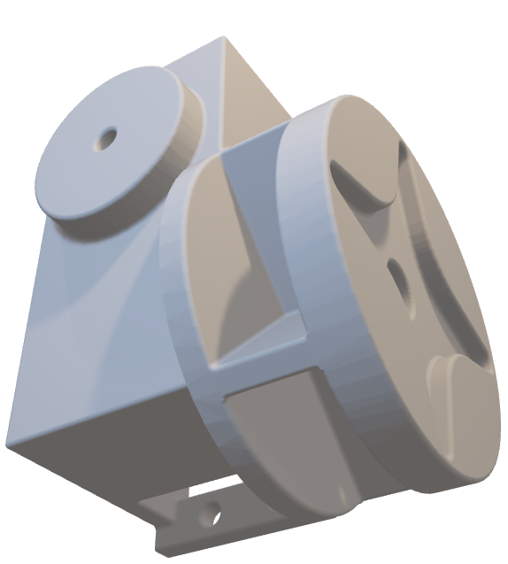
Perpendicular Link (Elbow)

Slide 4
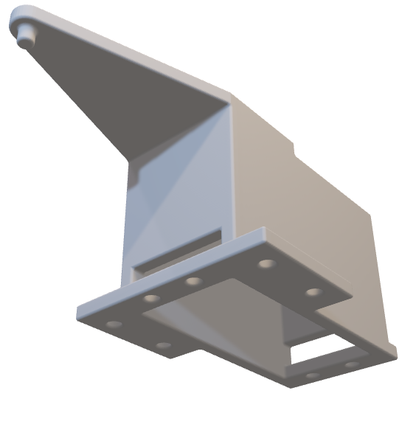
Offset Axial Link (Arm)

Slide 5
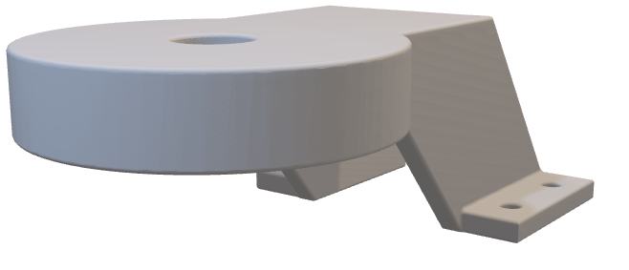
Arm Connection

Slide 6
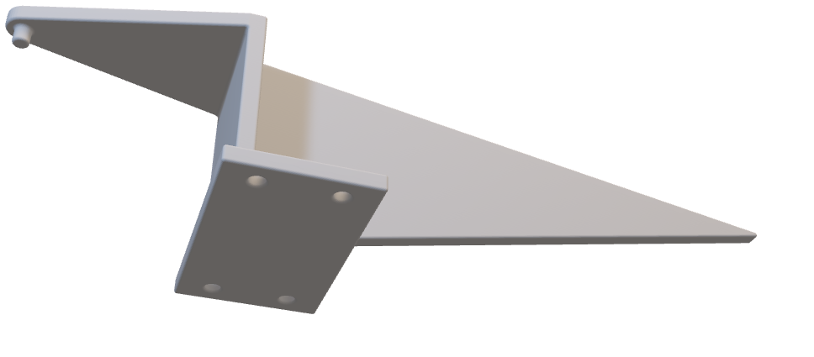
End Effector

